Slide 1

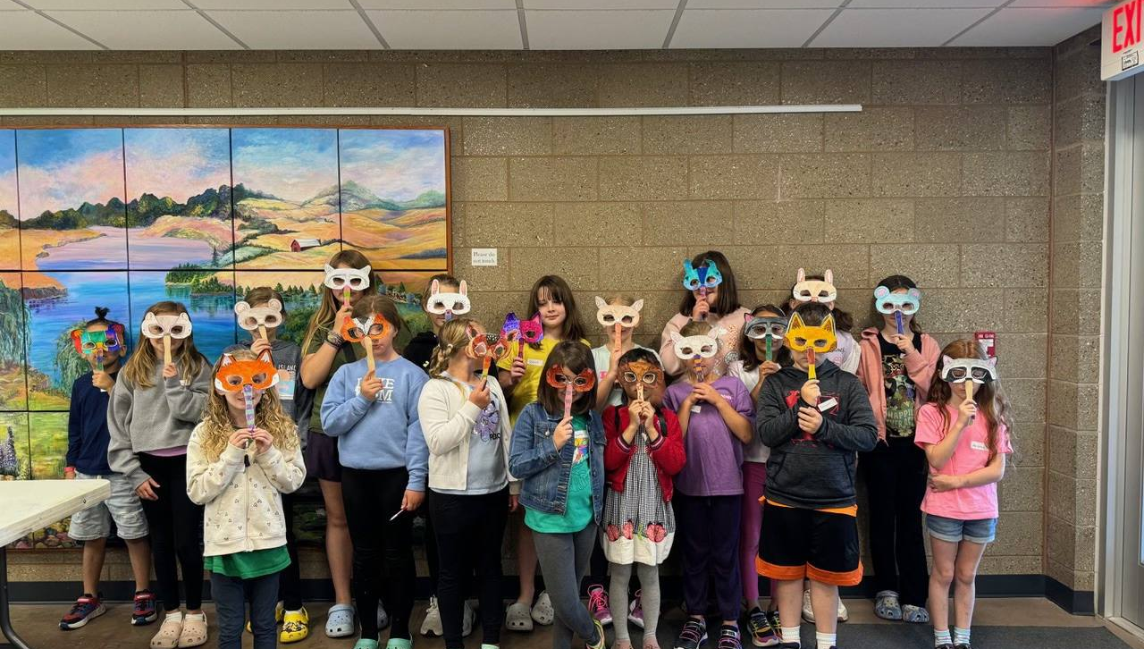
2024
Annual Report

Slide 2
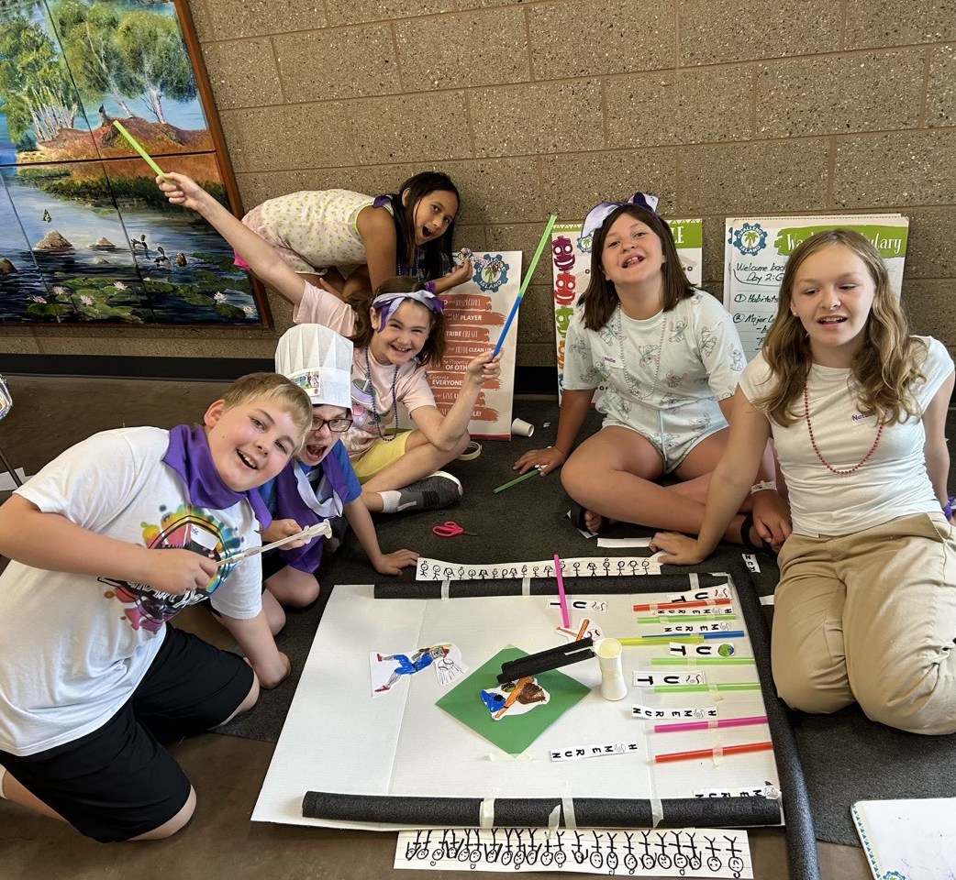
SLPR MISSION: Establish, maintain, and operate a system of parks, recreation facilities and programs.
SLPR VISION: Offer park, recreational facility, and program opportunities that enhance the education, physical health, personal well-being and social interactions within the community.
SLPR HISTORY: ESTABLISHED IN NOVEMBER 2000 BY A VOTE OF THE PEOPLE FROM FENTON TWP, CITY OF FENTON, & CITY OF LINDEN UNDER THE METROPOLITAN DISTRICT ACT, PA 312-1929. A .4 MIL PERPETUAL OPERATING MILLAGE WAS APPROVED. (ROLLED BACK BY HEADLEE AMENDMENT.)
Mission, Vision & History

Slide 3
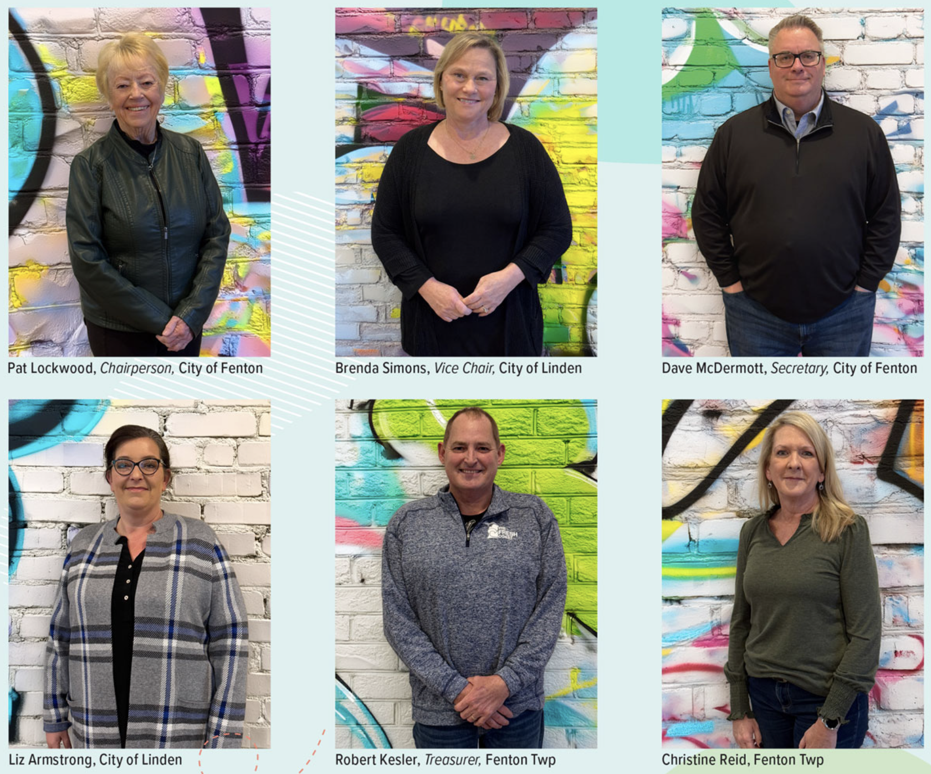
Current Board of Commissioners
Patricia Lockwood
Chairperson, City of Fenton
Brenda Simmons
Vice Chair, City of Linden
Rob Kesler, Treasurer
Treasurer, Fenton Township
Dave McDermott
Secretary, City of Fenton
Christine Reid,
Commissioner, Fenton Township
Liz Armstrong
Commissioner, City of Linden

Slide 4
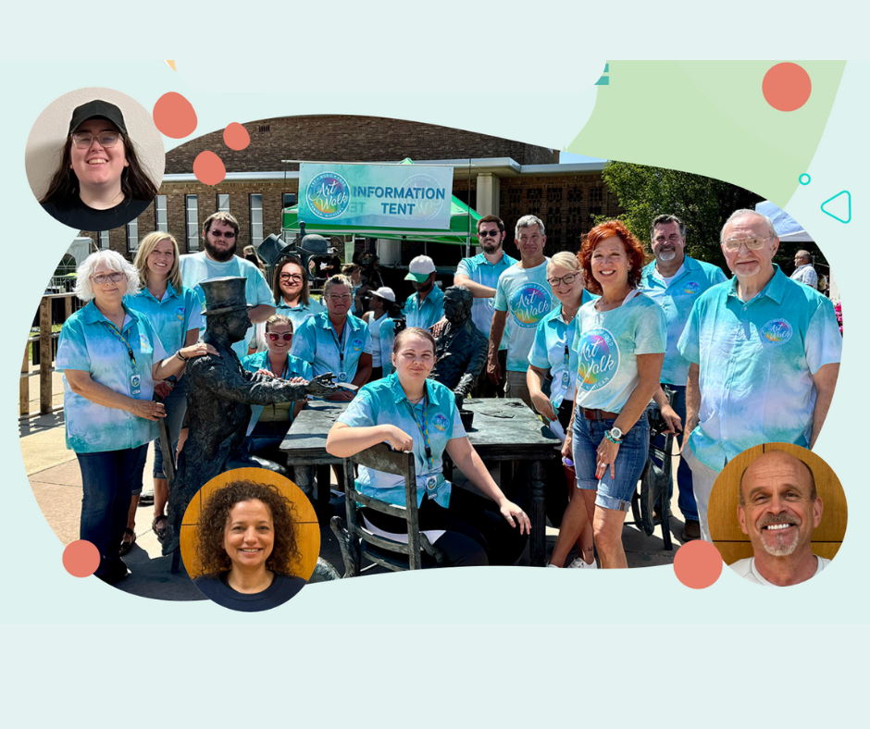
Administrative Staff
Ed Koledo
Executive Director
Shirley Priestap
HR/Accounting Coordinator,
Fitness Director
Mike Gagne
Athletic & Recreation Programmer,
Fenton Schools Facility Scheduler
Kristen Archambeau
Marketing Coordinator,
Recreation Programmer,
Dance Director
Courtney McMillan
Program Coordinator/Office Manager
Molly Henderson
Administrative Assistant,
Farmers Market Manager
Sherie Peruski
Lindsey Barker
Jeff Alderman
Administrative Assistant
Cameron Foland
Tim Foland
Becky McDermott
Rick Naughton
Melvin Bartsoff
Stephanie Lewis
Evelyne Ayotte
Program & Building Attendant
Cathy O’Bee
Aquatics Director

Slide 5
2024 Property Tax Millage from SLPR District

Slide 6
Property Tax Revenue

Slide 7
Revenue & Expenses

Slide 8
Fund Equity Growth

Slide 9
Contribution to LOOSE Senior Center
SLPR Year to Date Contributions to LOOSE SENIOR CENTER: $1,733,774

Slide 10
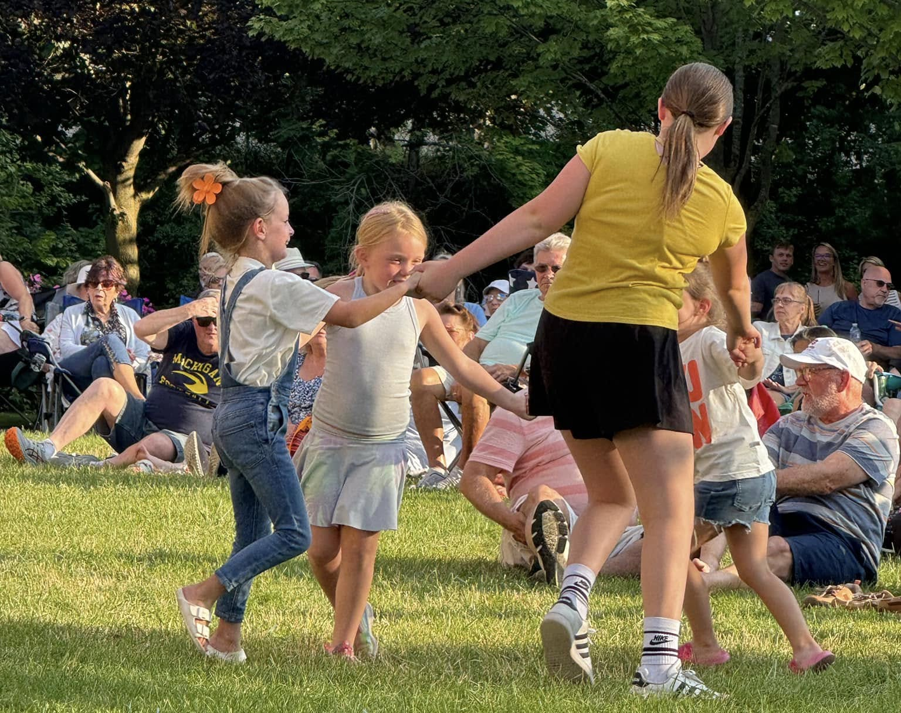
Participant Residency
Fenton Twp 29%
City of Fenton 23%
City of Linden 9%
Tyrone Township 12%
Argentine Township 5%
Mundy Township 3%
Grand Blanc 2%
Holly/Rose Twp 6%
Other 11%

Slide 11
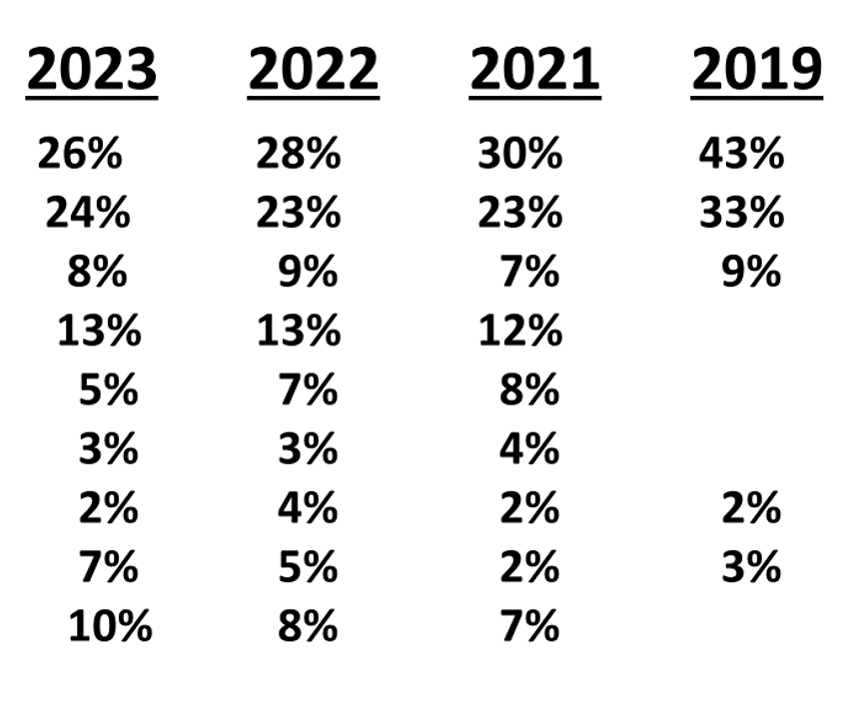
Participant Residency
2024
Fenton Twp.
City of Fenton
City of Linden
Tyrone Twp.
Argentine Twp.
Mundy Twp.
Grand Blanc
Holly/Rose Twp.
Other
29%
23%
9%
12%
5%
3%
2%
6%
11%
11

Slide 12
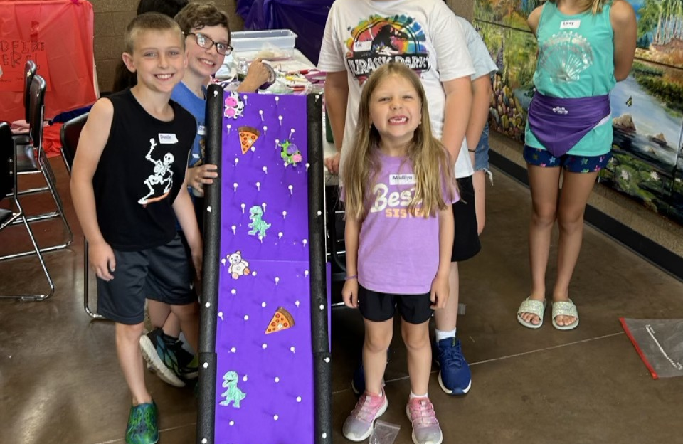
Survey Questions
Is this your first time taking an SLPR class? 29% Yes, 71% No
Was staff helpful and knowledgeable? 96% Yes, 4% No
Was the instructor enthusiastic and qualified? 95% Yes, 5% No
Did you and/or your child enjoy the program? 96% Yes, 4% No
Was the cost of the program competitively priced? 91% Yes, 9% No
Would you take the program again? 90% Yes, 10% No
Customer Satisfaction
How did you hear about us?
Word of Mouth 15%
Website 16%
Brochure 18%
Social Media 22%
Newspaper 20%
Other 9%

Slide 13
Program Hours of Use by Location

Slide 14
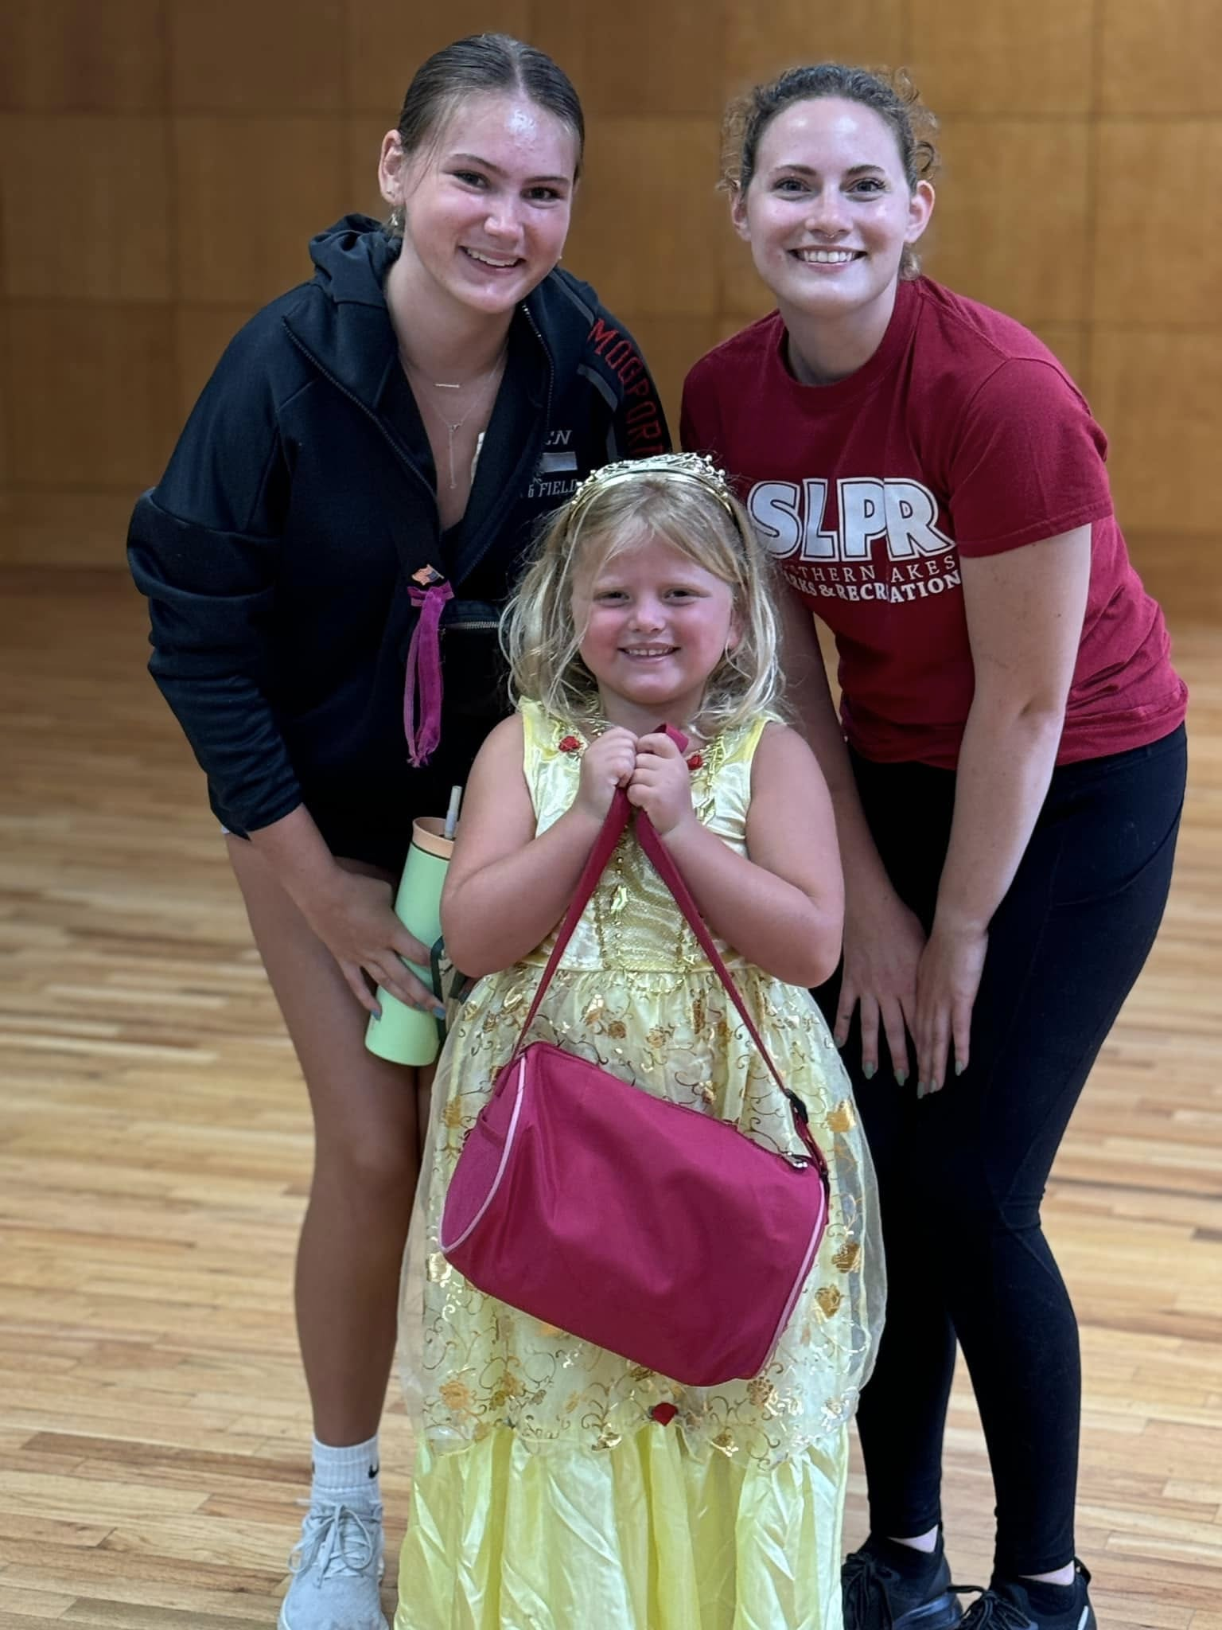
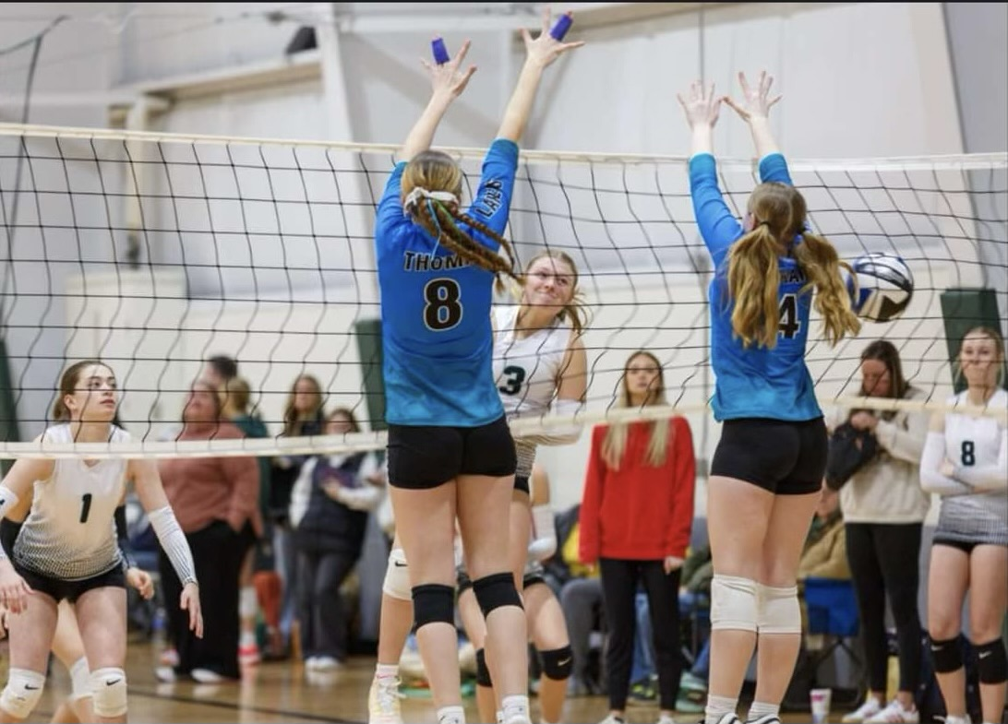
Youth Program Highlights
2024
2023
2022
YOUTH Registered Participants 3202 3503 2825
YOUTH Program Opportunities 352 336 353

Slide 15
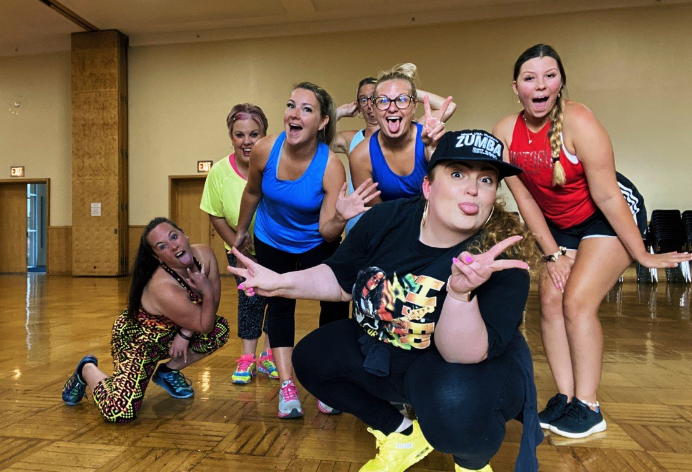
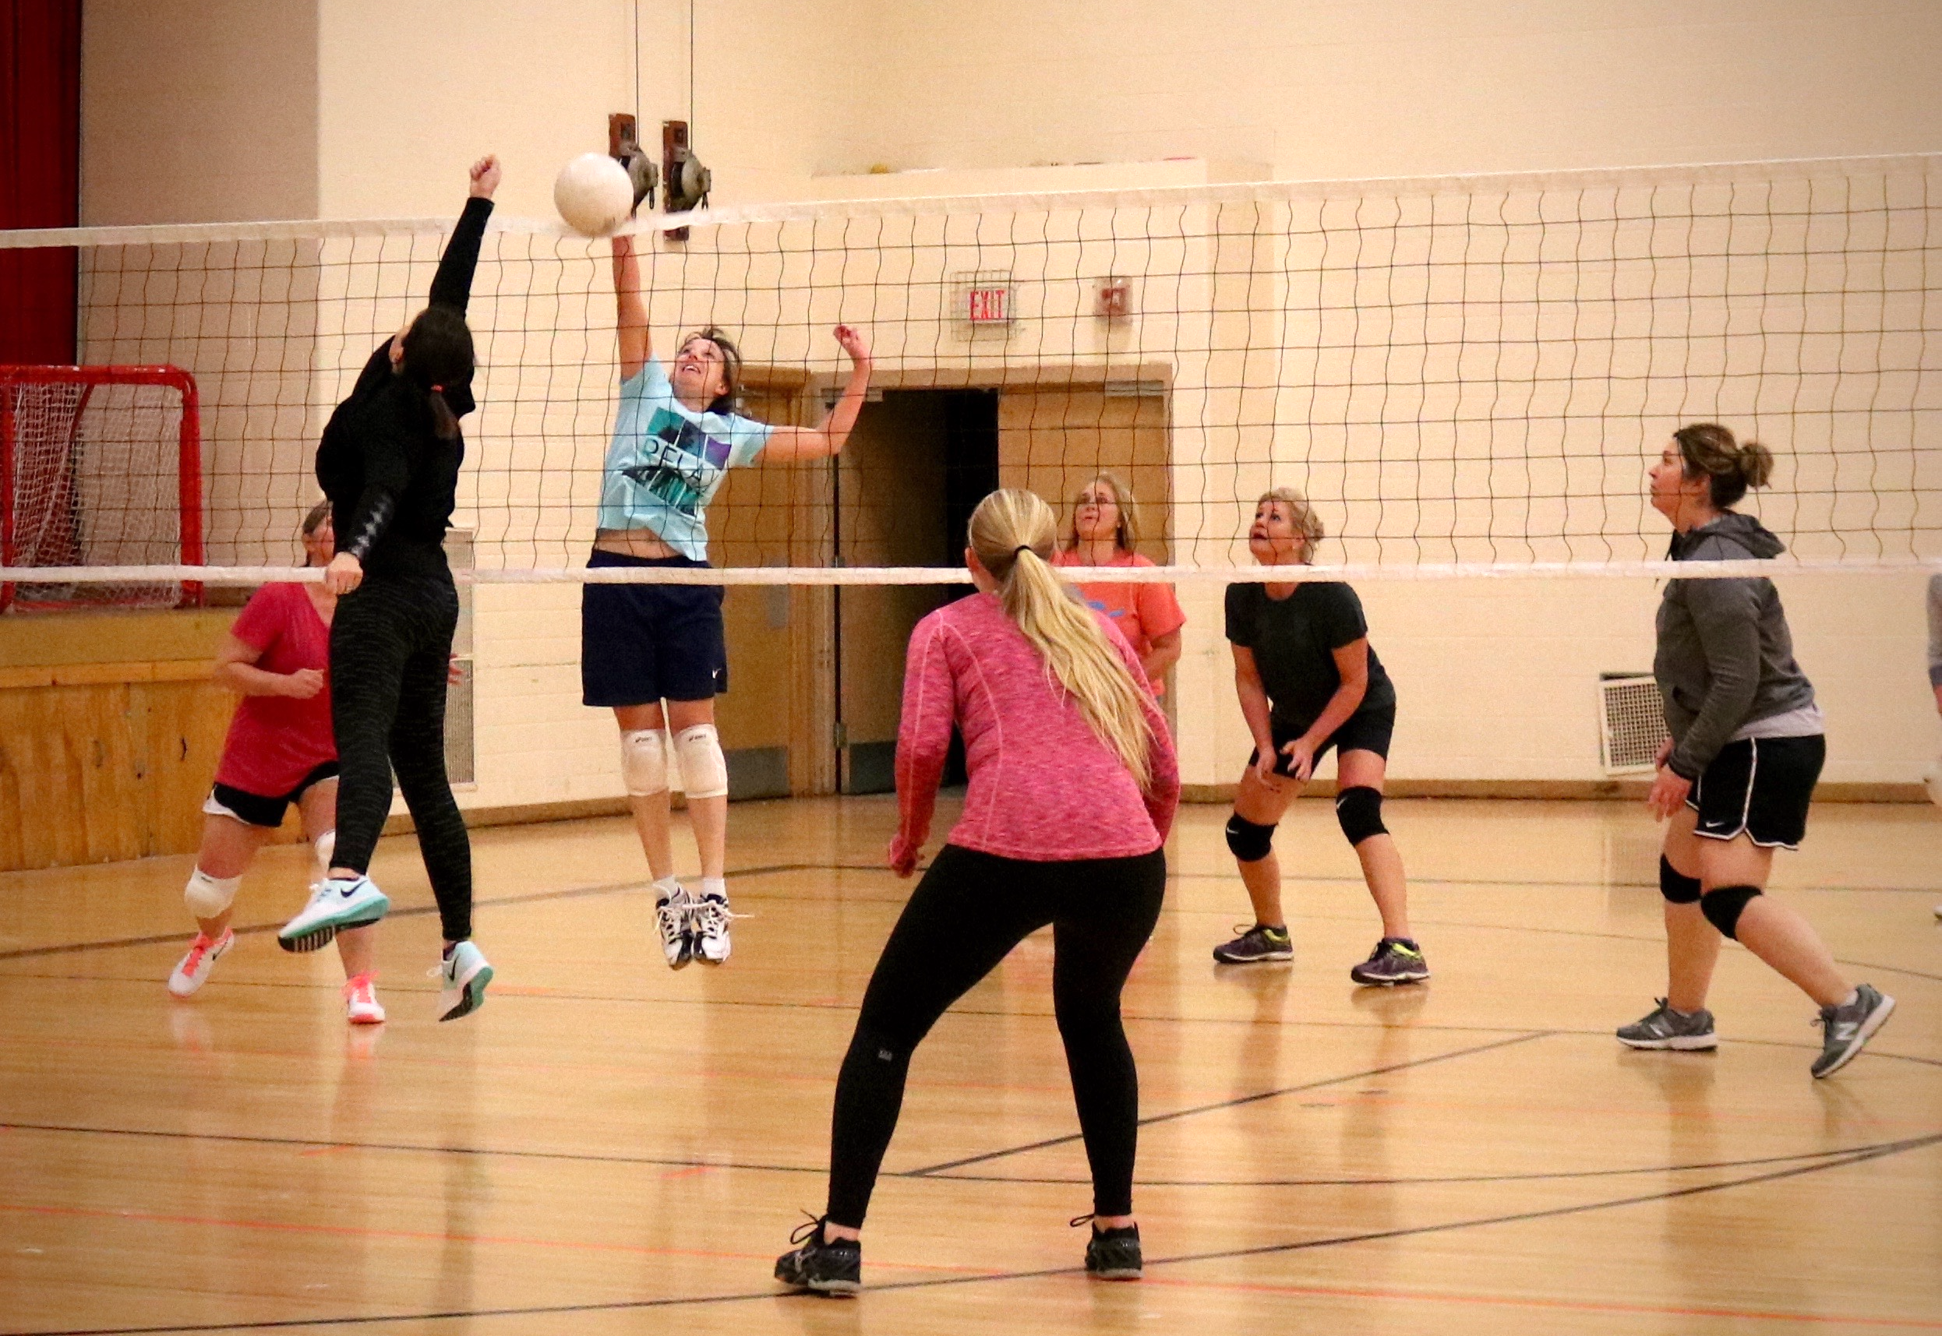
Adult Program Highlights
2024
2023
2022
ADULT Registered Participants 1519 1852 685
ADULT Program Opportunities 191 186 172

Slide 16
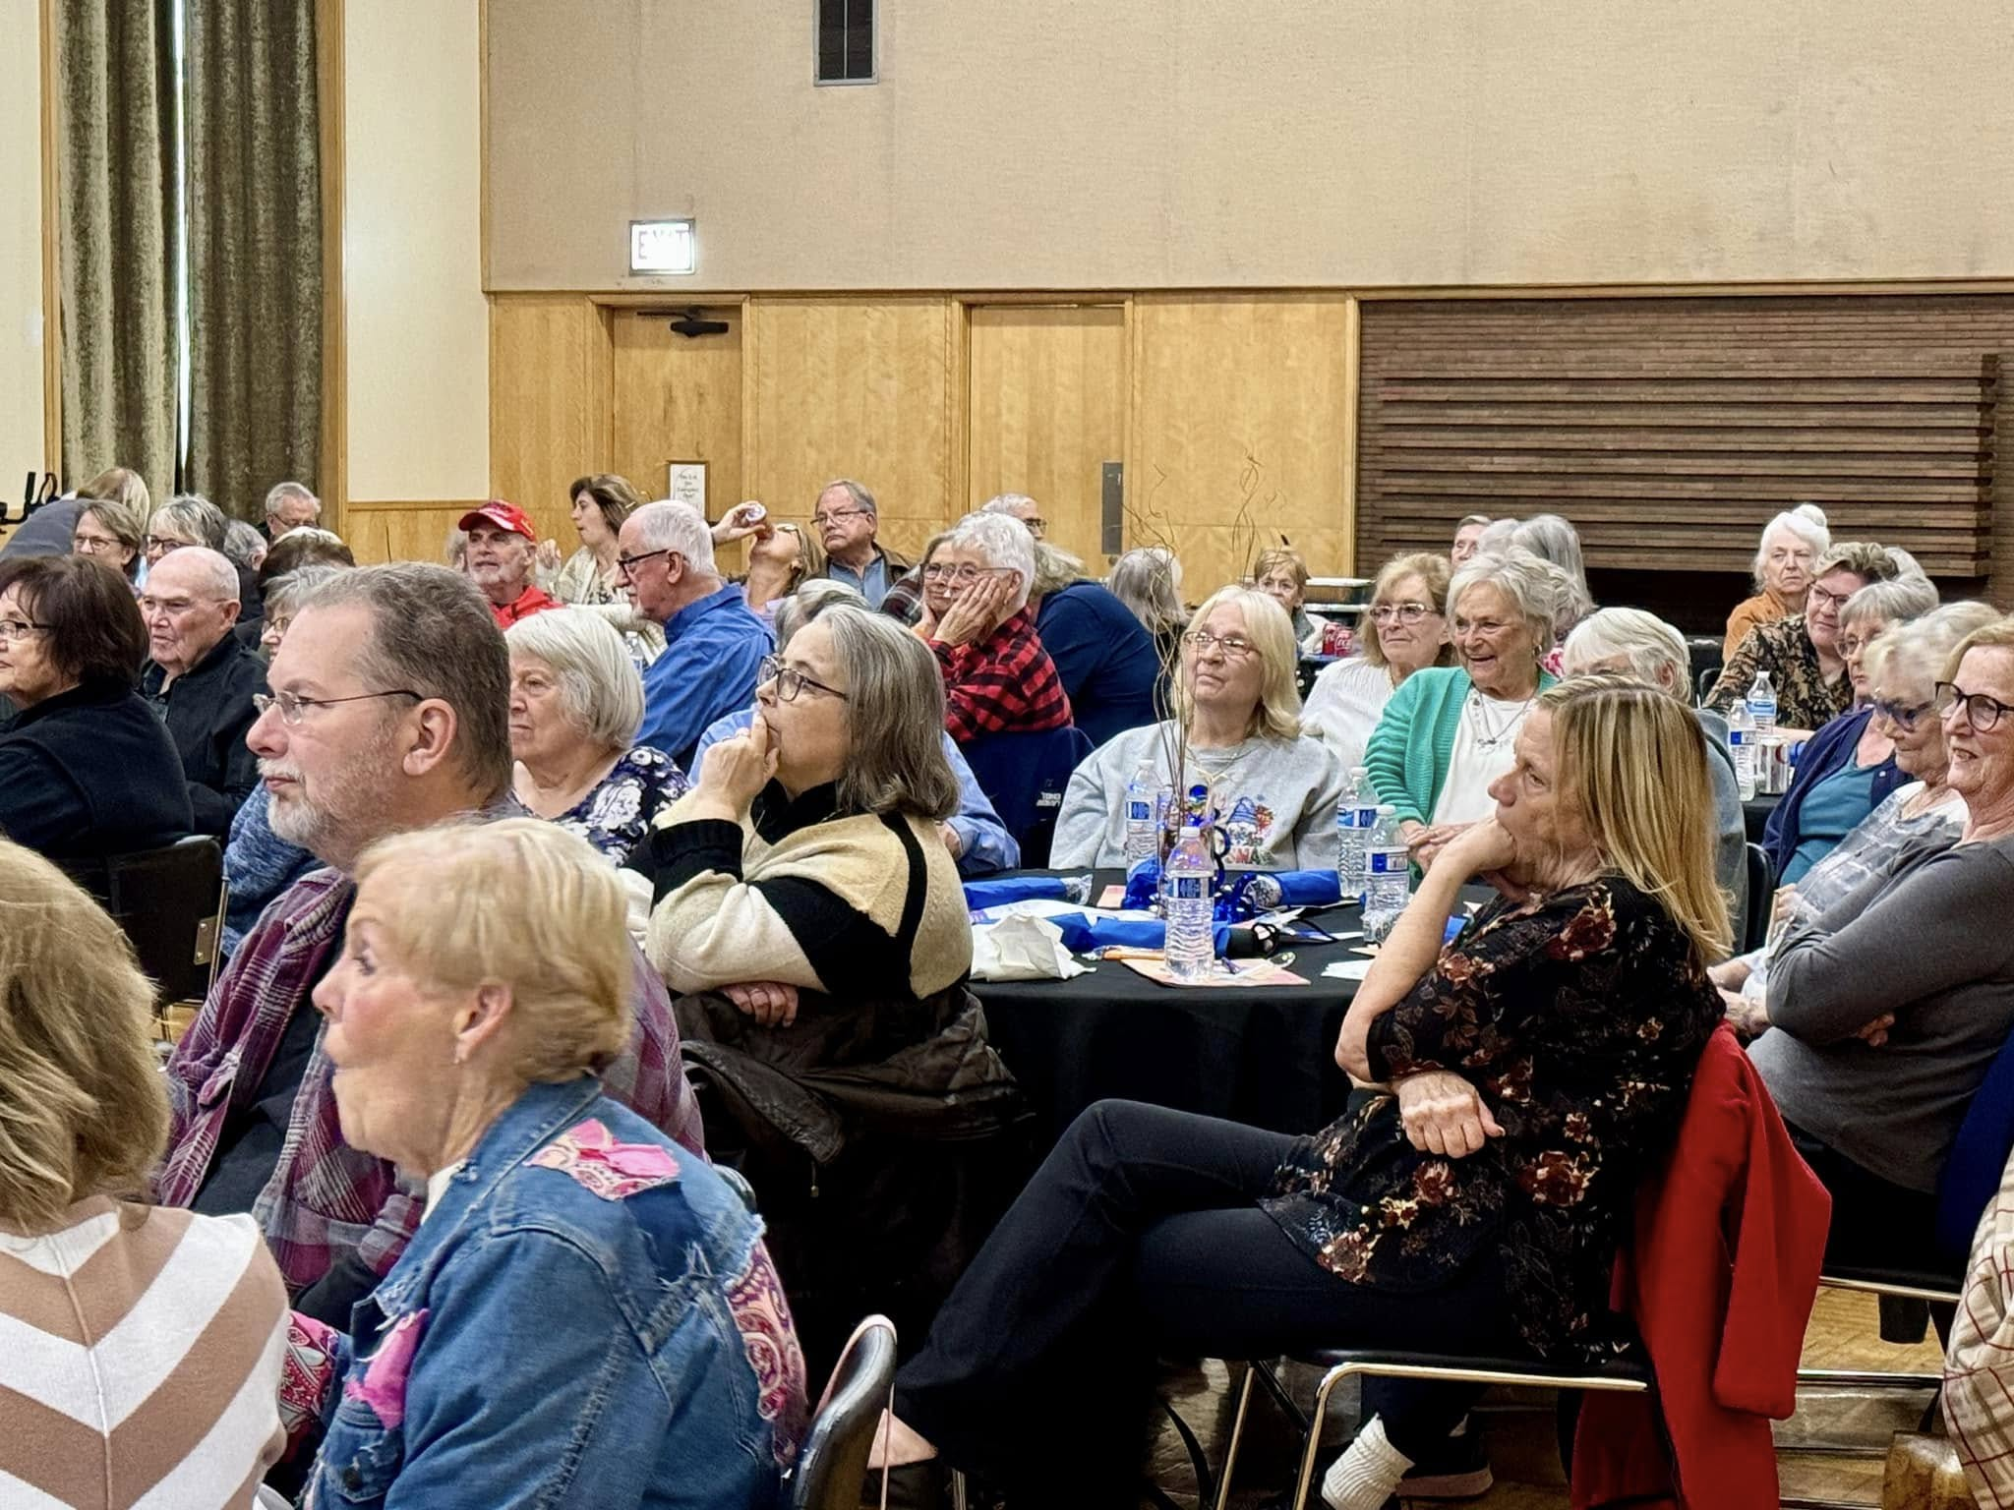
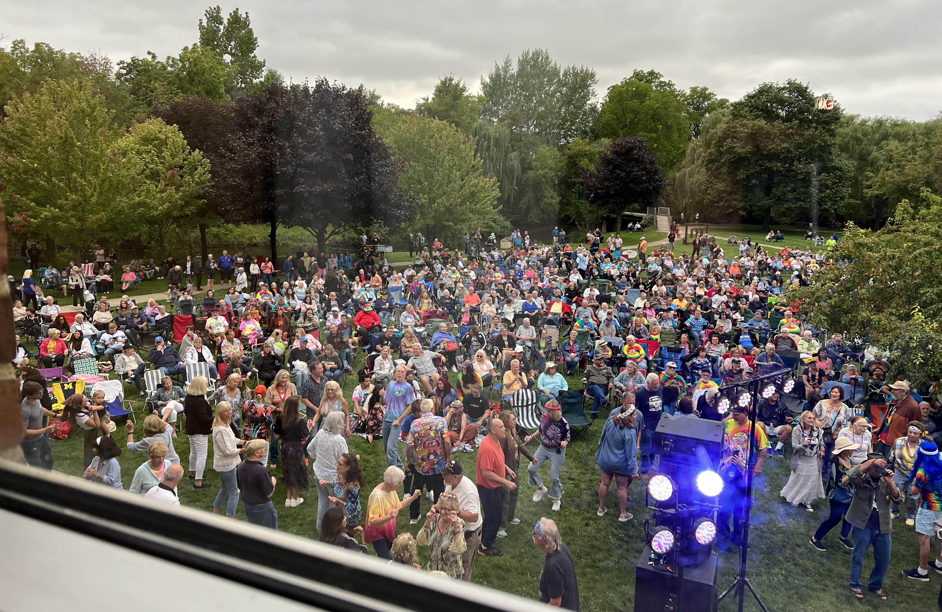
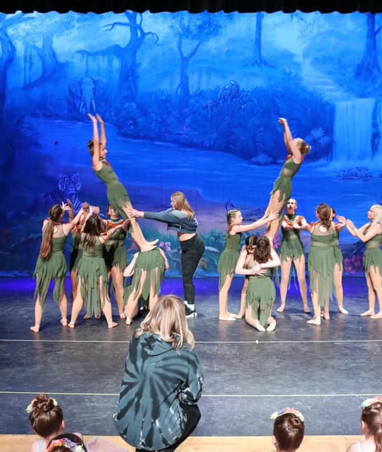
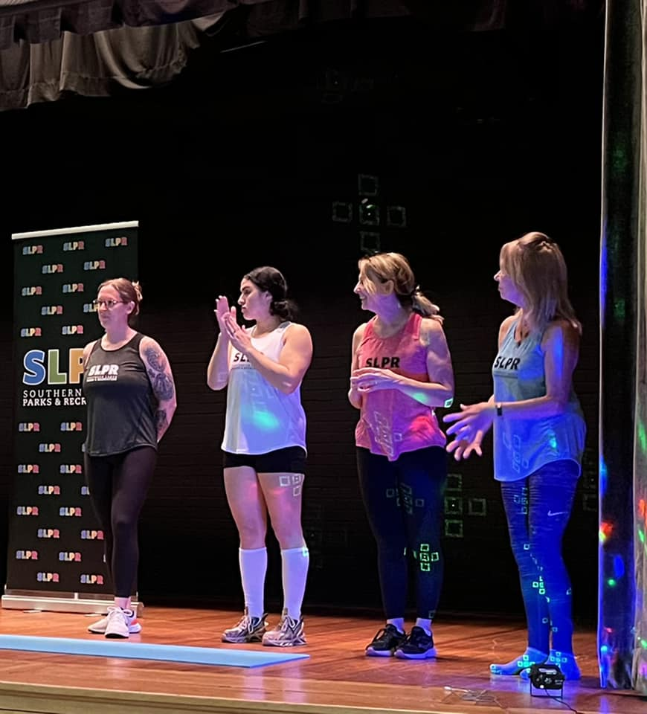
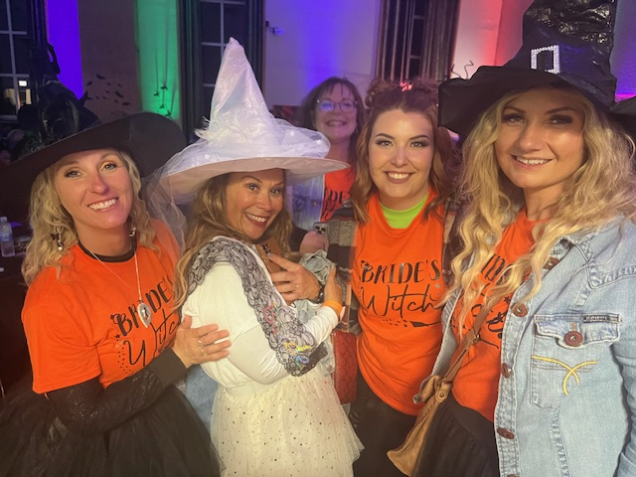
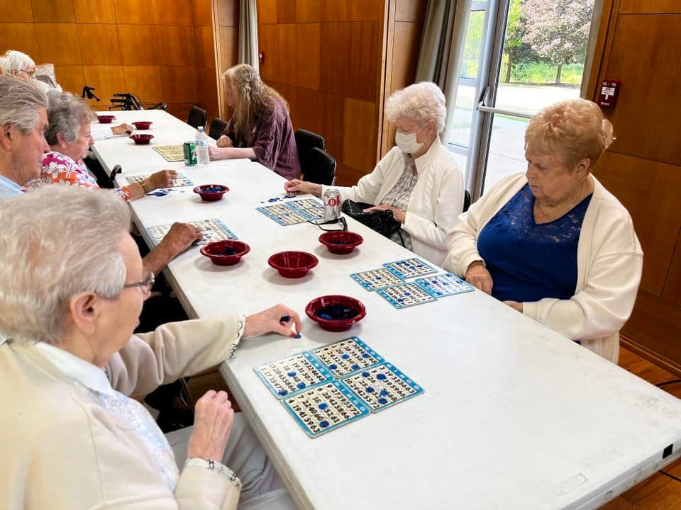
Special Events
Spring Dance Recital
Fall Dance Showcase
Senior Brunches
Witches & Wizards Ball
Senior Fridays
Free Fitness Friday

Slide 17
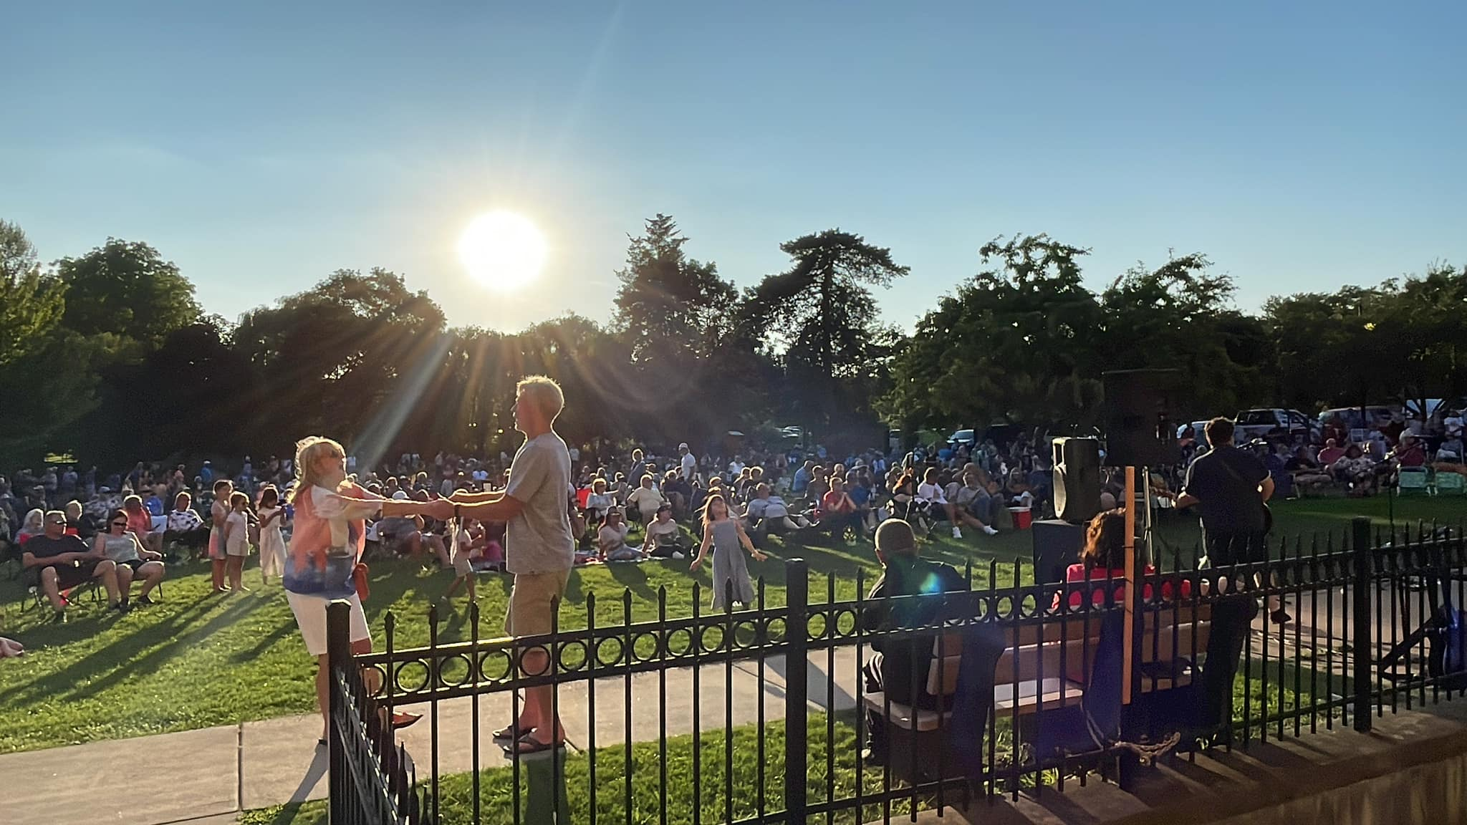
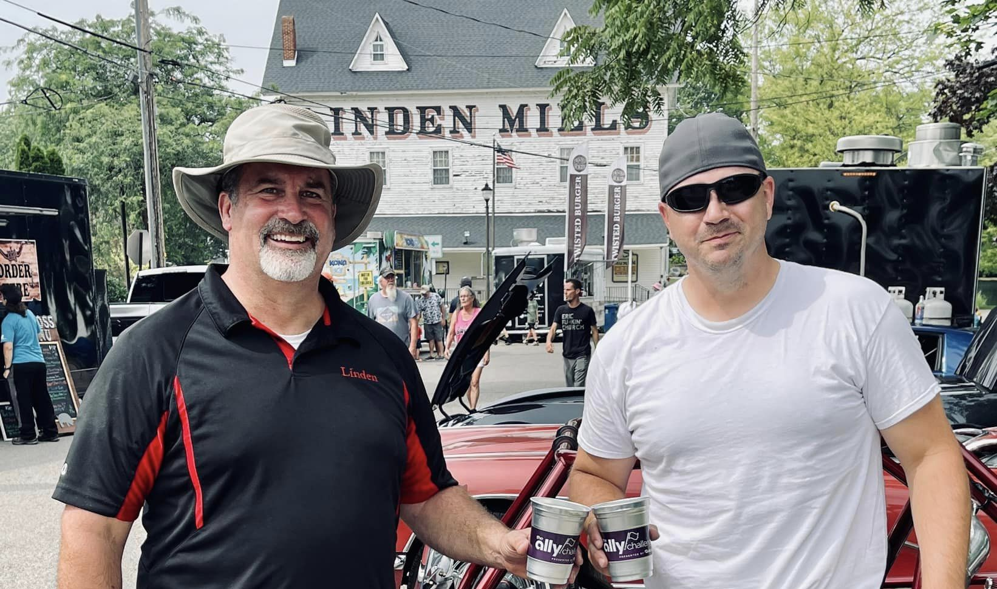
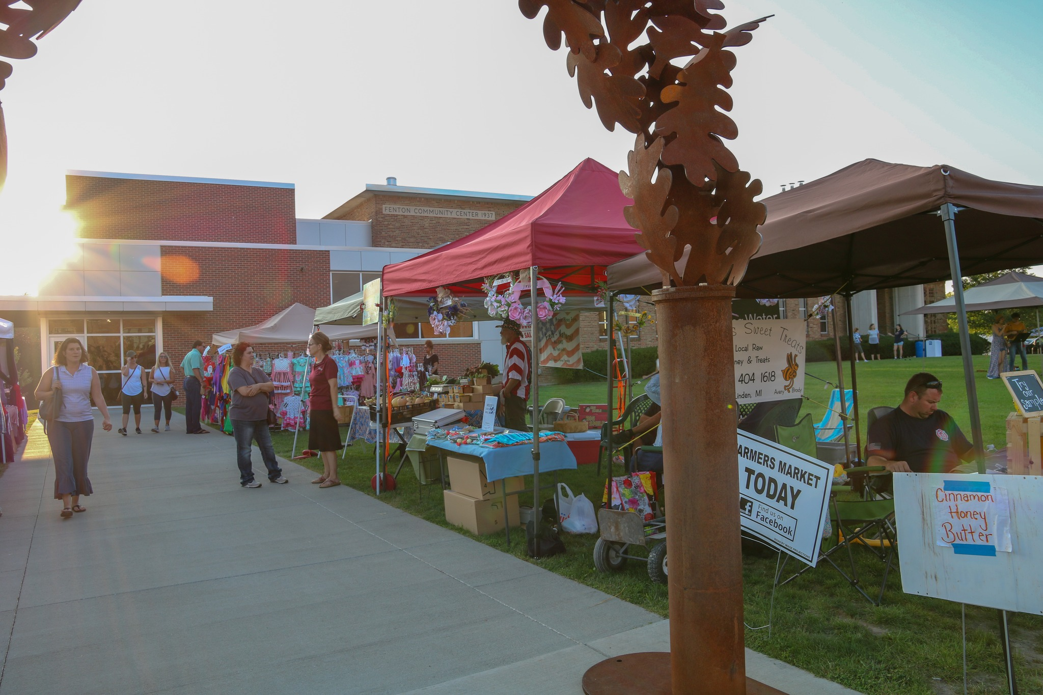
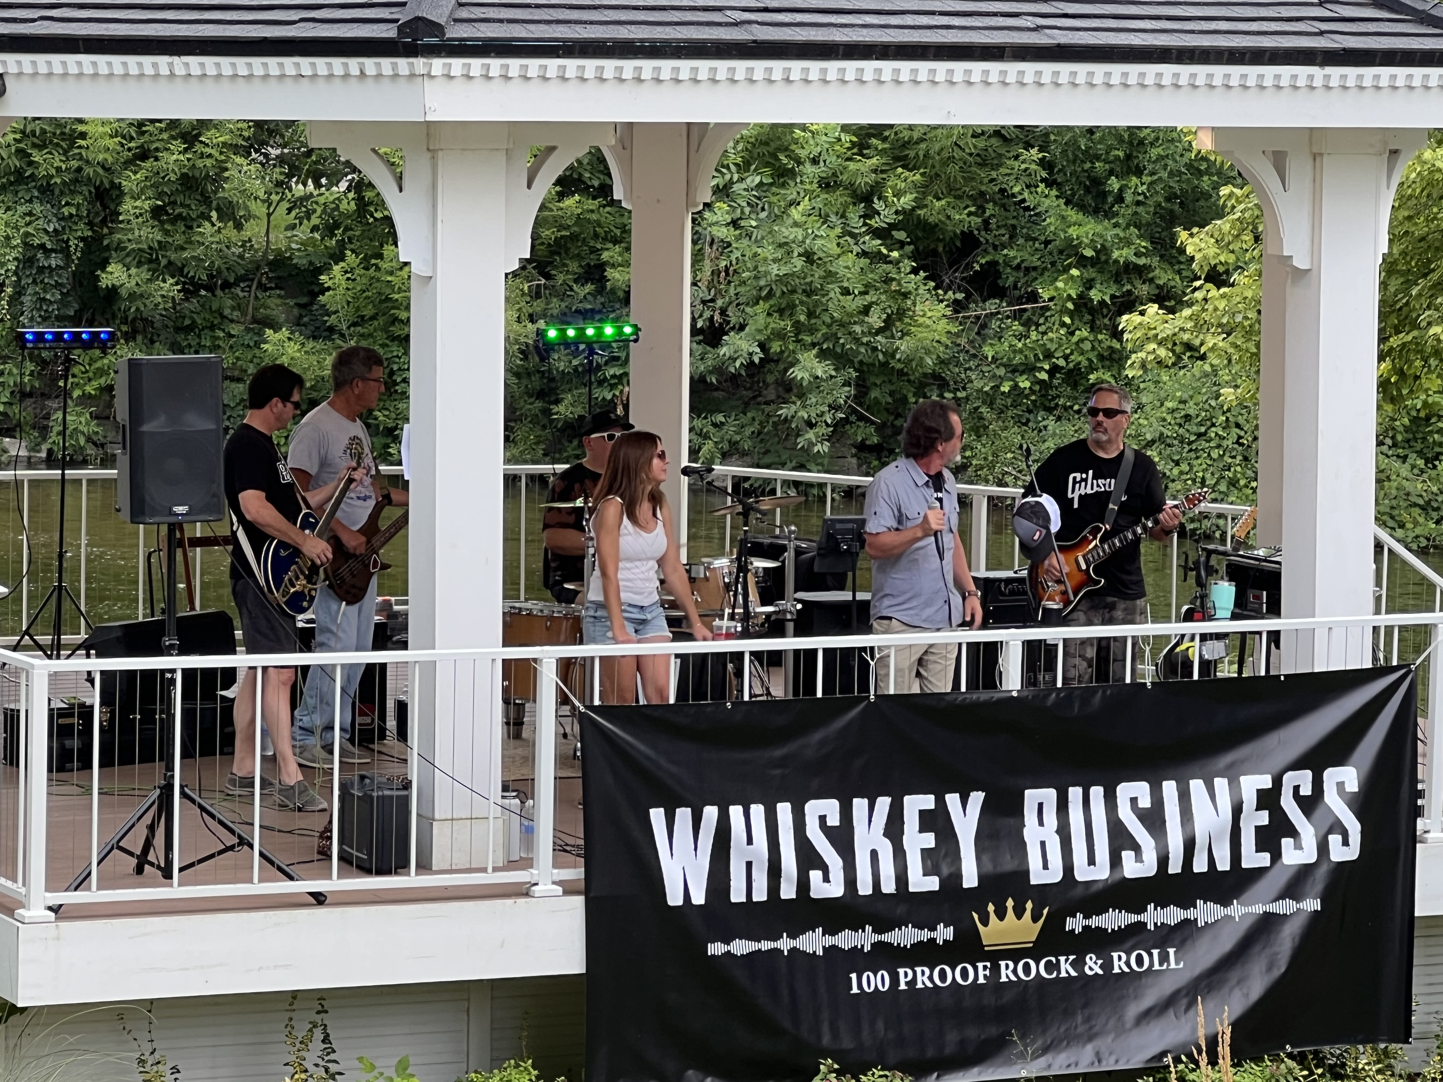
Community Events with
Farmers Market, B2B Tune Up Parties, Fenton Art Walk, Family Nights in Fenton
Fenton & Linden Summer Concert Series, Ladies Night Out, In-kind Sponsorships with Project Graduations, HIL’s River Roast, Keepers’ Riverfest, & Silver Lake Park Family Days

Slide 18
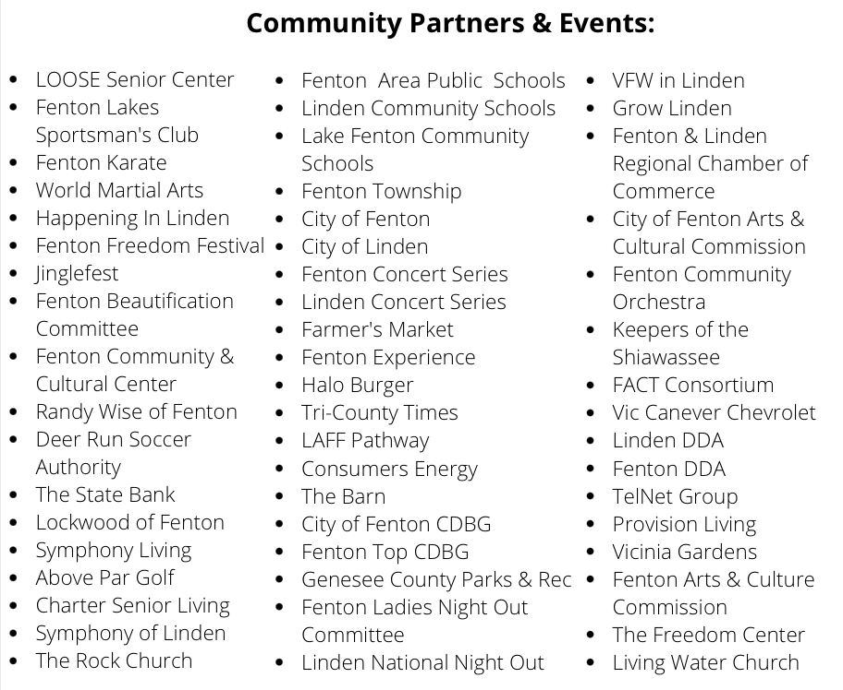
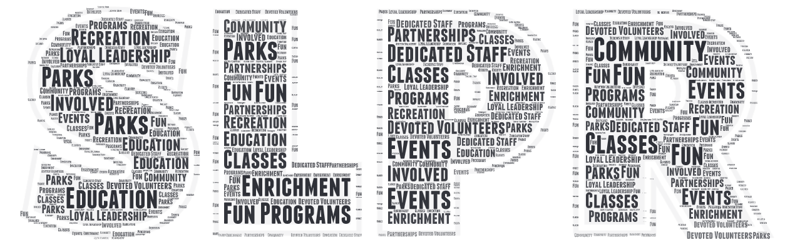
It’s All About Community!
SLPR greatly appreciates the municipalities, schools, volunteers, sponsors & grantors for their community support.

Slide 19
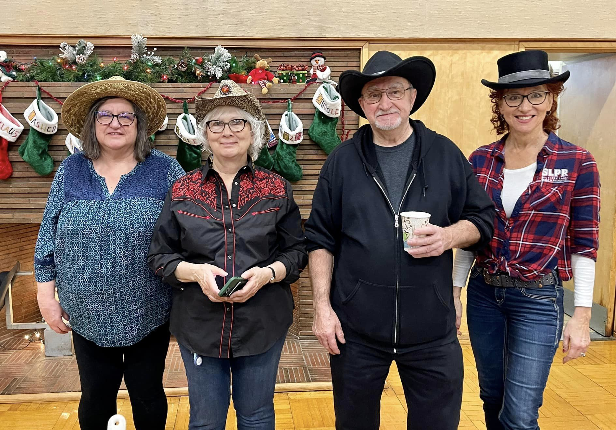
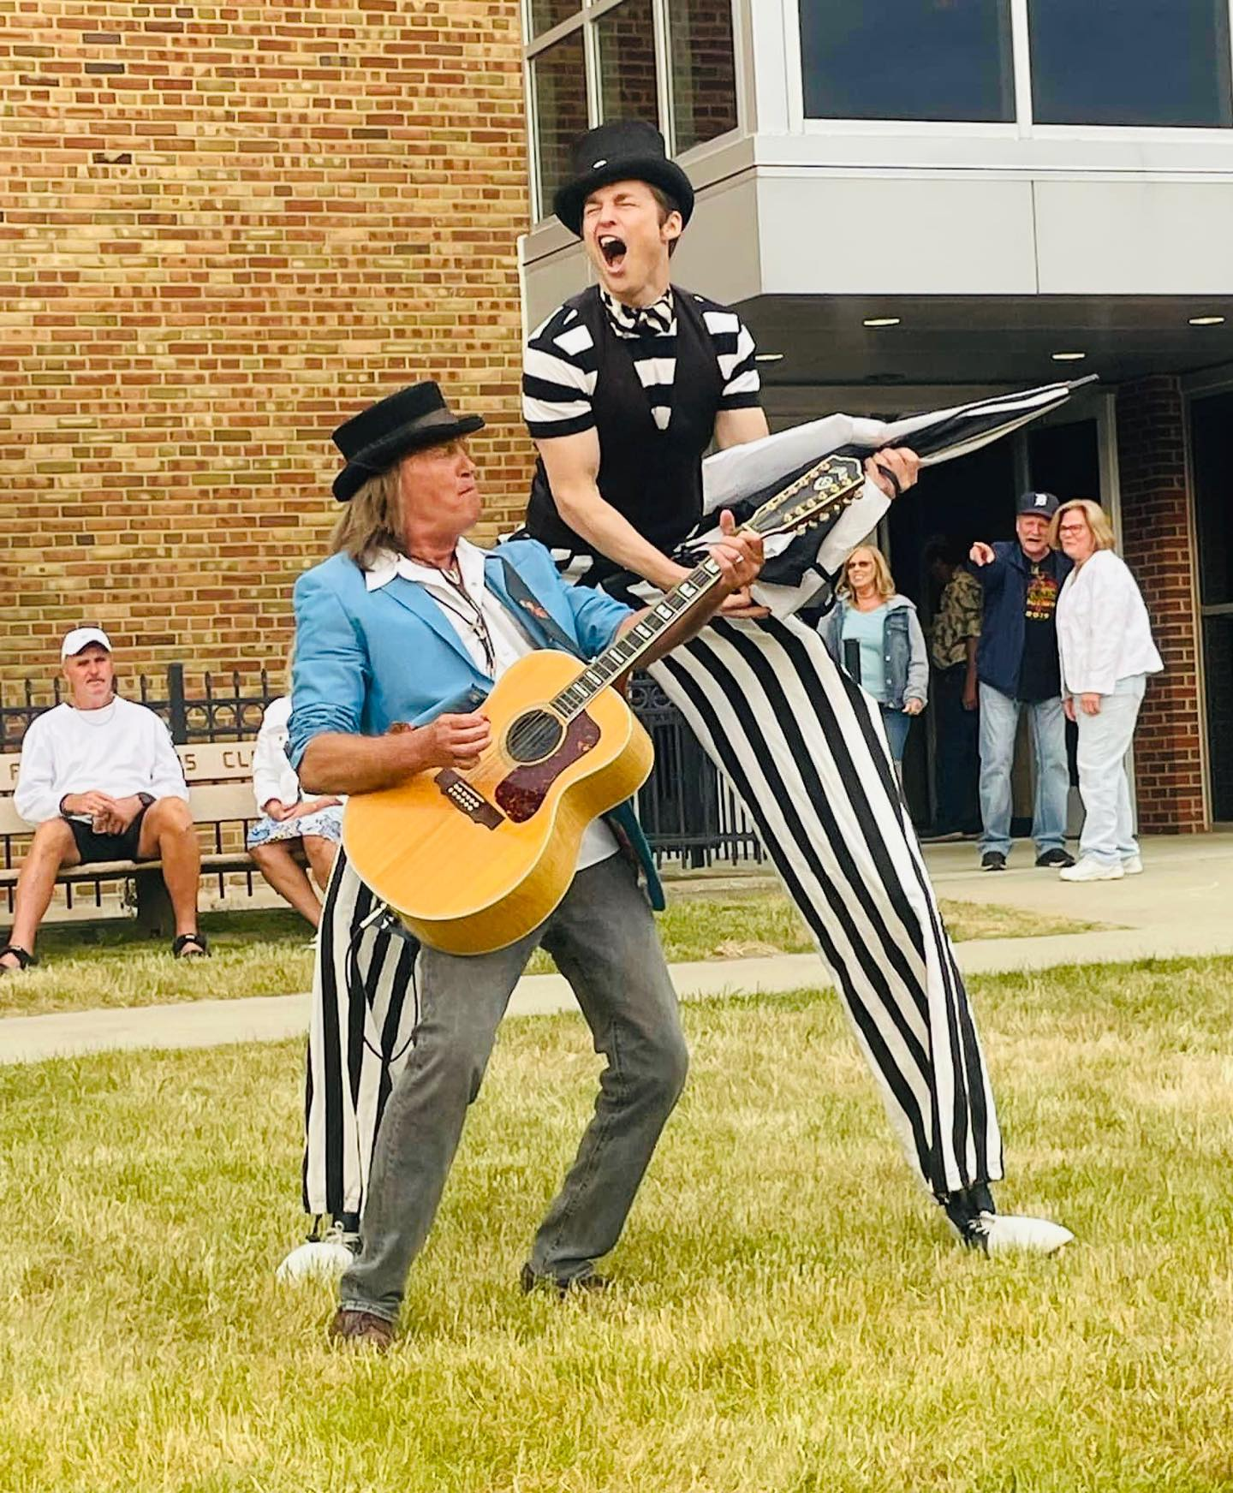
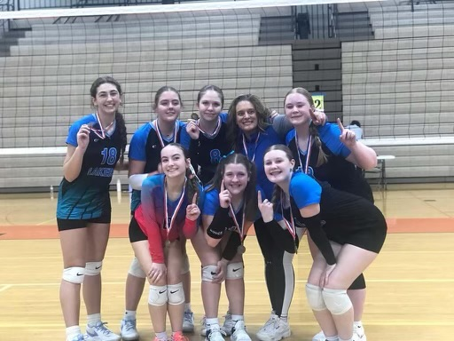

Another FUN Day with…
YEAR!!!
www.slpr.net

Slide 20
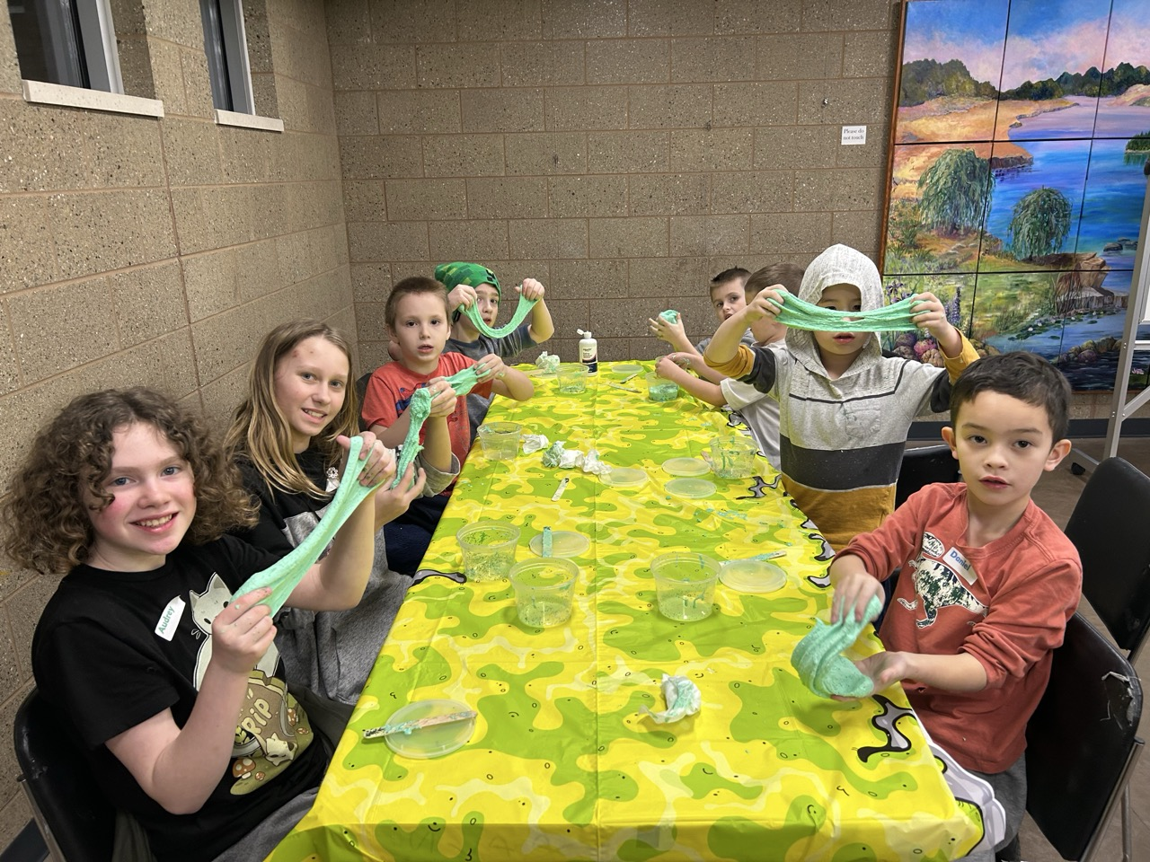
Looking Forward to 2025!
Concerts in the Park in Fenton
Concerts in the Park in Linden
Family Days at the Fenton Experience
Farmers Market in Fenton
Art Nights at the Fenton Experience
Fenton Art Walk
21st Annual Spring Dance Recital
Wrestling Tournament
Pilates Workshops
Memorial Day Concert in Linden
Senior Fridays
Senior Brunches
Craft Brews and News
Challenge Island Classes
Fall Dance Showcase
Riverfest
Working towards the State Bank Trail
Watercolor Art Classes
STEM Classes & Camps
Hosting Networking at Noon in December
Craft Shows
Community Garage Sale
Free Fitness Friday
Wellness Expo
Square Dancing Events

